Slide 1
URBAN VISION
HACKATHON
Indian Institute of Science, Banglore

Slide 2
Overview of the Hackathon
Phase 01
The first phase of this hackathon has resulted in the creation of one of the largest and most diverse vehicle detection datasets (from top-down CCTV view) for Indian urban environments, for Bengaluru—one of the world’s most congested cities.
This dataset, comprising approximately 50,000+ high quality annotated images, is a significant leap forward towards making work for AI.

Slide 3
Overview of the Hackathon
Phase 01
Phase 02
The first phase of this hackathon has resulted in the creation of one of the largest and most diverse vehicle detection datasets (from top-down CCTV view) for Indian urban environments, for Bengaluru—one of the world’s most congested cities.
This dataset, comprising approximately 50,000+ high quality annotated images, is a significant leap forward towards making work for AI.
Participants need to filter the provided week-1 dataset.
Participants will use the provided dataset to train their AI models.
Train object detection models in any of these three Model categories: Small, Medium, and Large.
f the team is satisfied with the quality, they will submit a docker file. We will be evaluating their models against larger set of ground truth images (held-out test set) and results on the leaderboard will be posted in an automated way.

Slide 4

630+
120
1500+
4
Team Stats
Teams
Cities
Students
Weeks

Slide 5
Why This Hackathon
Tackling Urban Congestion at Scale
Addressing congestion problems in Bengaluru the world’s 3rd most congested city
Lack of Existing Datasets
Existing datasets does not capture the complexity Indian traffic, especially from top-down CCTV views.
Leverage Existing Infrastructure
Utilizes the widespread CCTV networks already deployed across cities, enabling easy scalability beyond Bengaluru with minimal additional setup.
Community Participation
By involving the community in data annotation, the project transforms AI development and fosters a sense of ownership and collaboration.

Slide 6
Public Data Annotation
6.51 Million Bounding Boxes using the Interface
Many Data annotation softwares already exists.
Then what we did new?
Made a custom interface which is easy to navigate and use for the participants
Developed an algorithm for fair evaluation of the submitted annotations, even without ground truth
Getting data annotated by other methods can be slow and expensive. In this hackathon, we used crowdsourced data annotation, where the community helped label the data. This made the process much faster and more affordable. It’s also scalable to other cities using the same approach, without relying on expensive services.

Slide 7
6.51 Million
454,000
70,000
Phase 1 Stats
Bounding boxes added or Confirmed
Annotations Made
Unique Images

Slide 8
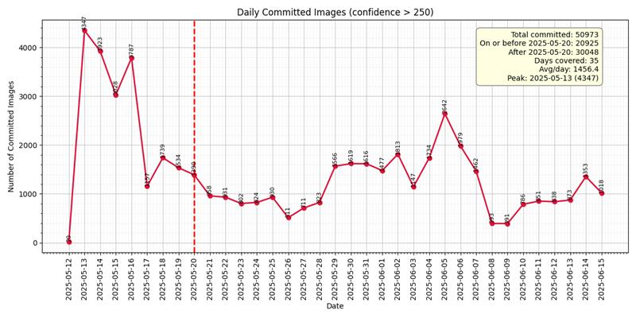

Slide 9
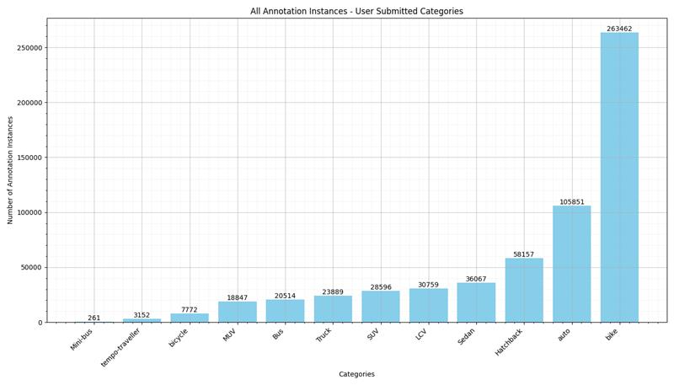

Slide 10
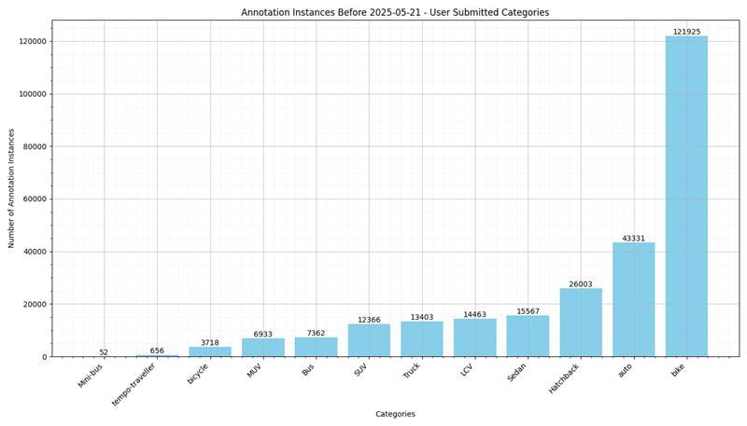

Slide 11
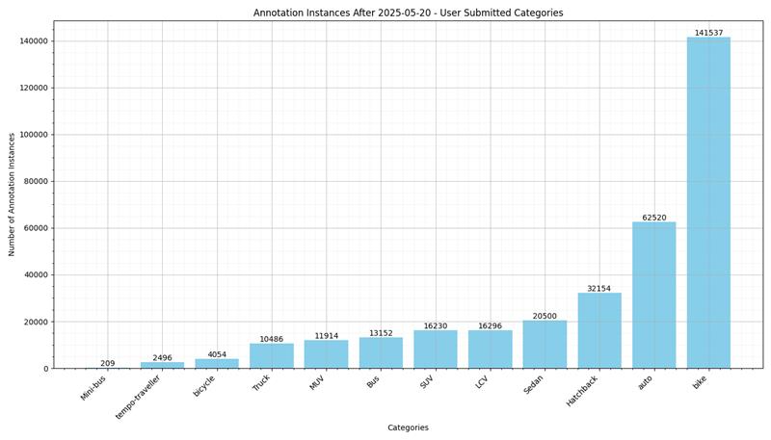

Slide 12
Vehicle Detection
Object detection is a computer vision task that does object localization and classification
The output of an object detection model for each detected object in an image includes:
Class Label: The category of the detected object (e.g., "hatchback", "van", "bus").
Confidence Score: A probability score (ranging from 0 to 1) representing the model’s confidence in the predicted class.
Bounding Box Coordinates: A set of four values that define the spatial location and size of the object in the image.
In practice, object detection models output a set of such predictions per image, often followed by post-processing techniques like Non-Maximum Suppression (NMS) to remove duplicate detections. This allows the system to detect and localize multiple objects of different classes in a single image.

Slide 13
Applications of Vehicle Detection
01
Detect and classify different types of vehicles
03
Vehicle Re-Identification across multiple CCTVs
02
Analyze traffic flow patterns and Congestions
04
Detect anomalies such as collisions using object movement patterns.

Slide 14
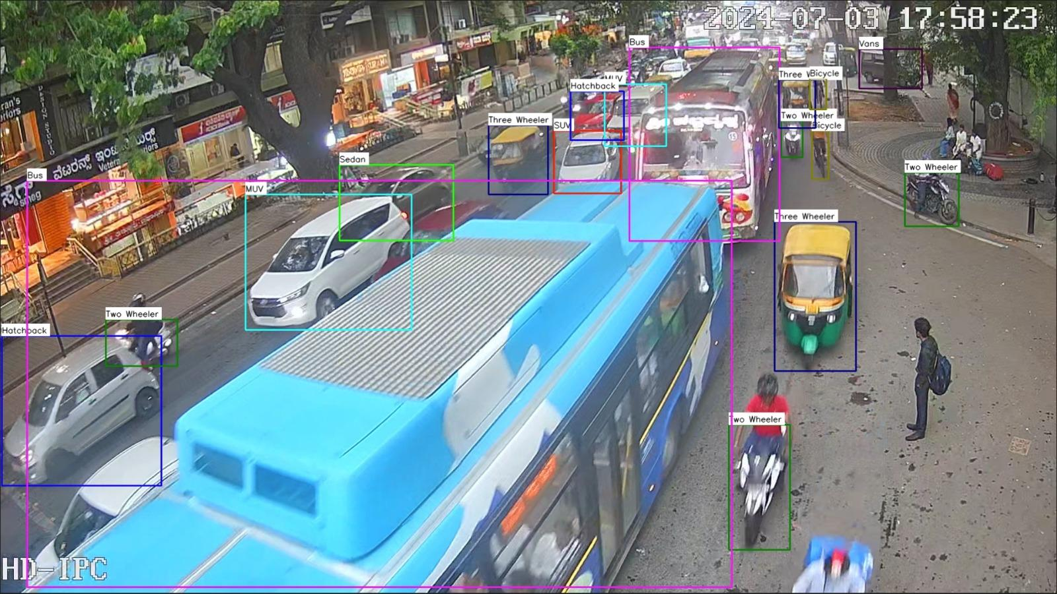

Slide 15
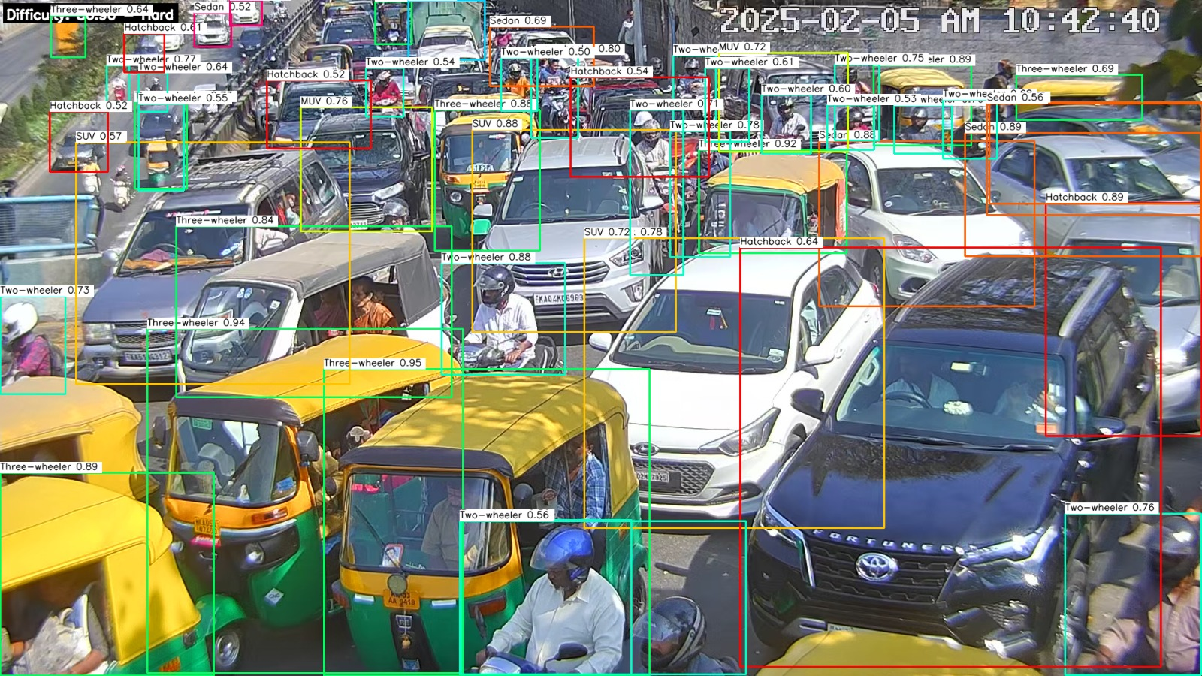

Slide 16
Format of a BBOX
01 Pascal VOC format
Output: xmin, ymin, xmax, ymax
(xmin, ymin): top-left corner
(xmax, ymax): bottom-right corner
02 COCO format
Output: x, y, width, height
(x, y): top-left corner
width = xmax - xmin
height = ymax - ymin

Slide 17
Evaluation Metrics
Intersection over Union (IoU)
IoU is a fundamental metric used to evaluate the accuracy of object localization in object detection tasks. It measures the overlap between the predicted bounding box and the ground truth bounding box.
IoU= Area of Union / Area of Overlap
​Area of Overlap: The region where the predicted and ground truth boxes intersect.
Area of Union: The total area covered by both boxes combined
IoU values range from 0 to 1:
IoU = 1: Boxes completely overlap)
IoU = 0: No overlap at all

Slide 18
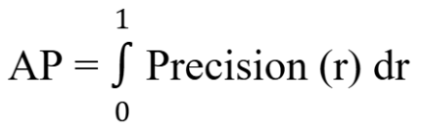
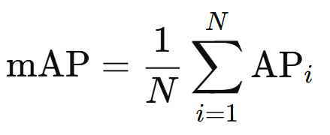
Evaluation Metrics
Average Precision (AP) & mean Average Precision (mAP)
AP is computed as the area under the precision-recall curve for a given class, capturing the trade-off between precision and recall across different confidence thresholds.
Where r is recall. In practice, AP is approximated using discrete points on the curve.
mAP is the mean of APs across all N classes, providing a single performance score for the model. It ranges from 0 to 1. Where 1 means a perfect detection.

Slide 19
Phase 1: UI and Processing
User Interface:
Designed for quick and intuitive annotation
Showed baseline (pre-annotated) bounding boxes
Processing:
A subset of the data that we have collected from the hackathon will be used by you guys for training, as well as us for future use
We have collected a lot of direct and indirect metrics from a lot of participants using our hackathon online platform, which will be shown in the upcoming slides

Slide 20
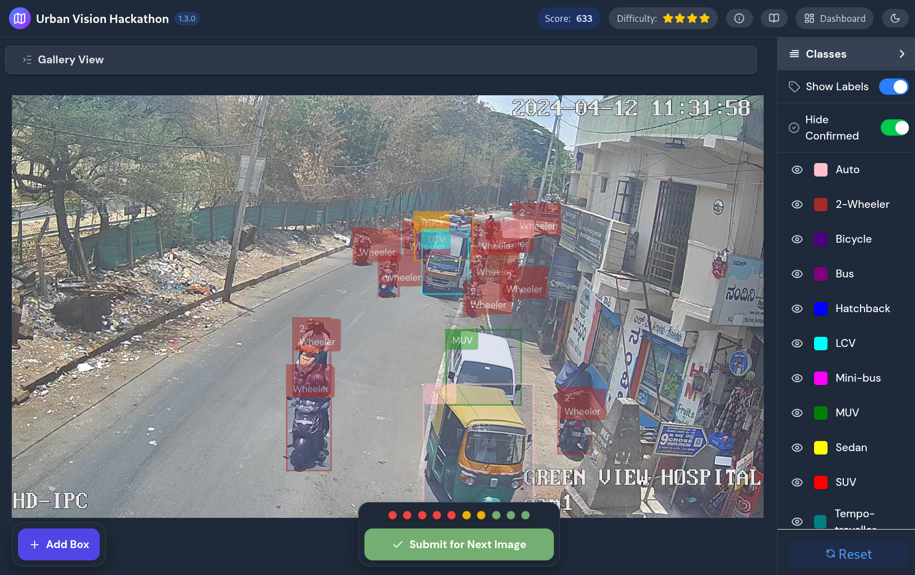
Custom Interface

Slide 21
What Participants Did
Task:
Review and correct baseline annotations
Add missing annotations and remove incorrect ones
Label objects (car, bike, pedestrian, etc.) accurately
Each image was annotated by multiple users, but within limit (max 7 users per image)

Slide 22
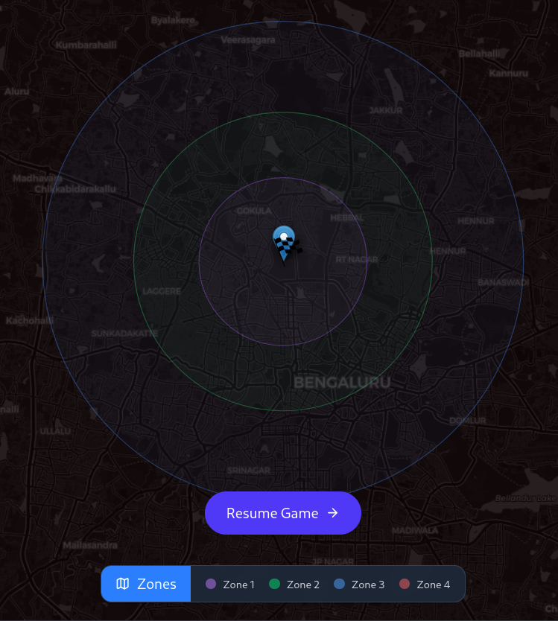
Zone Progression
Participating teams were divided into 4 different zones based on levels completed and annotation accuracies
Each user was assigned images from a specific zone to avoid overlap
Participants in lower zones (zone 1 and zone 2) were presented with more difficult images

Slide 23
Image Scheduling
Images are scheduled smartly such that the highest amount of images can be annotated and evenly distributed to participants
Images difficulty is based on user zone, participants in Zone 1 and 2 are served more difficult images

Slide 24
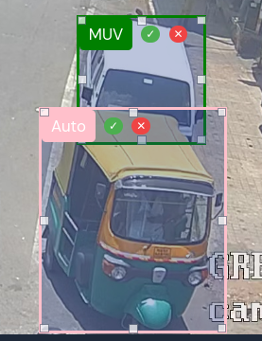
Data Collection
After submission, image annotations were sent to the server
Data was preprocessed and stored in the central database
Metadata such as annotation time, corrections, and scores also recorded

Slide 25
Ranking Metrics
AX Score:
Measures agreement with verified ground truth
Based on bounding box precision and class accuracy
FX Score:
Measures annotation effort per image
Based on confirmed bounding boxes vs. baseline
Total Score:
Measures consistent quality and quantity
Computed from combined AX and FX scores
Zone:
Participants in lower zones ranked higher due to greater difficulty
Reflects effort across levels and sustained accuracy

Slide 26
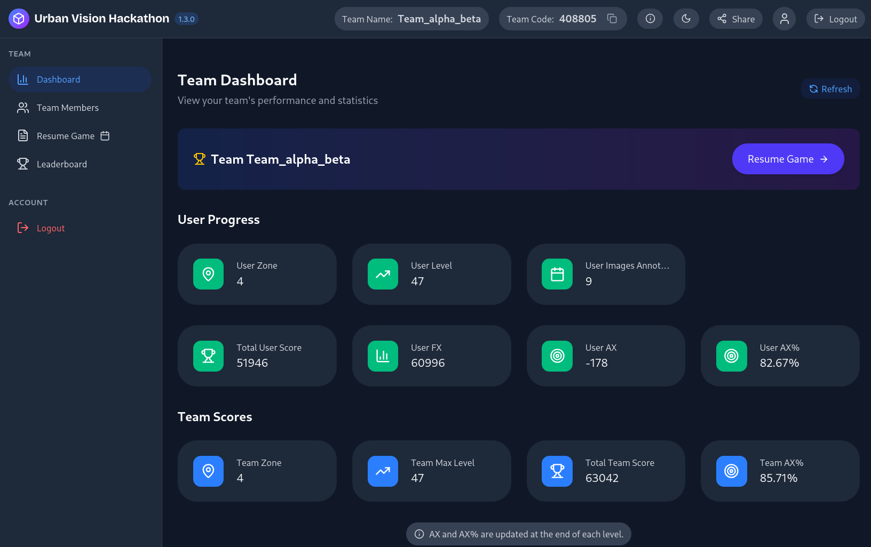

Slide 27
Dashboard Overview
Dashboard Entry & Phase-2 Access
Users first land on the Team Dashboard after logging in.
In the left sidebar, a new button labeled "Phase-2" is available.
When clicked, it redirects users to the Leaderboard section of Phase-2.
This button initiates access to advanced evaluation and submission stages.

Slide 28
Leaderboard Overview
Phase-2 Leaderboard Pages
The Phase-2 leaderboard area contains three tabs:
Final Leaderboard – Shows model performance based on submission scores
Validation Leaderboard – Reflects validation-based metrics
Bench Mark – Benchmark metrics for performance comparison
At the bottom of the page, a Make Submission button is provided.
Clicking this opens the Submission Page.

Slide 29
Submission Page
Making a Submission
Users land on the Rules Page before submitting.
Two submission types are available:
Final Submission → submit text data
Validation Submission → upload a JSON file
All users must agree to hackathon rules before submission is accepted.
Ensures all entries are legitimate and meet the competition criteria.

Slide 30
Submission History
View Submission History
After submitting, users can click "Submission History".
Shows:
List of all Model Submissions
List of all Validation Submissions
Displays: Id, Status, Message, Executed At, Submitted At Timestamp
Helps teams monitor past attempts and track performance improvements.

Slide 31
Summary
Phase-2 Workflow – Summary
🔹 Dashboard: Users access Phase-2 via the sidebar button
🔹 Leaderboards: Navigate between Final, Validation, and Benchmark pages
🔹 Make Submission: Choose between Final (text) or Validation (JSON) submissions
🔹 Rules Page: Accept terms before proceeding
🔹 Submission History: Track past performance and improvements

Slide 32
Phase 2 - Working

Slide 33
Accessing the GPU Clusters
Connect via University VPN
To access internal compute resources, VPN access is mandatory.
Visit math.iisc.ac.in/sshinfo.html for detailed VPN setup instructions.
Supported via OpenVPN / Cisco AnyConnect.
Use your temporary team credentials to log in.
Ensure VPN is active before proceeding to SSH.
SSH into the Cluster
SSH (Secure Shell) is used to remotely access the terminal of the GPU nodes.
Basic SSH command: ssh username@hostname
Tips:
Use tmux to prevent session loss during training.
Do not run jobs directly on the login node — use SLURM to schedule jobs (explained in next slide).

Slide 34
Getting the Dataset
Option 1: Copy From Shared Directory (once you're on the cluster)
Each team has read-access to the shared dataset.
Command to copy dataset to your account:
cp -r /share/datasets/vehicle-detection ~/my-dataset
Option 2: Download from Online Links
If you prefer working on your local machine or online notebooks, download the dataset using:
Google Drive
Microsoft OneDrive
These contain the same dataset as on the cluster.

Slide 35
Syncing Your Codebase
For Collaboration (Team of 4)
Each team has a private Git repo under our organization.
Use Git to sync code between team members.
We will look for:
Training & inference scripts
Code quality and structure
Version control & commit history
We require you to provide a git commit hash when submitting your valset
Recommended Workflow:
git clone https://github.com/our-org/team01-vehicle-detection.git
git pull # to fetch latest
git push # to upload your changes

Slide 36
For Using the Cluster (Transfer to/from local)
Use scp to copy files (e.g., trained weights, data snippets, env files) between local and cluster.
Copy from local to cluster:
scp -r ./myfolder username@compute-node:~
Copy from cluster to local:
scp -r username@compute-node:~/outputs ./outputs
make sure you’re connected to the VPN!
Keep your codebase clean — modular functions, proper file structure.
Push regularly — don’t keep everything local!
Avoid large binary files (like .pt models) in Git — use scp for those.

Slide 37
Online Notebooks (Colab, Kaggle)
Why Start Here?
Before jumping to cluster compute, begin your development in a flexible, beginner-friendly environment:
Easier for debugging and experimenting
No job scheduling or SSH hassle
Pre-installed packages, GPU available
Great for:
Dataset exploration & cleaning
Preprocessing & augmentations
Prototyping training pipelines
Training lightweight models
Google Colab: Free GPU (T4/P100)
Kaggle Notebooks: 30h GPU quota/week (Tesla T4)

Slide 38
Online Notebooks (Colab, Kaggle)
Suggested Workflow
Clone your team repo in the notebook: !git clone <https://github.com/our-org/team01-vehicle-detection.git>
Work on preprocessing / smaller model training.
Once confident, move pipeline to the cluster using scp.
⚠️ Avoid wasting SLURM hours on early trial-and-error stages.

Slide 39
Setting Up Your Python Environment
Why You Need This
Clusters don’t come with Python environments pre-installed.
To manage dependencies cleanly and avoid version conflicts, we recommend using:
Miniconda
Lightweight Python environment manager
Ideal for isolated project setups
Easy to use even for beginners
Conda environments are persistent, even after logout
Avoid installing system-wide Python packages — always use your environment
Pro Tips

Slide 40
Running Jobs on the Cluster (SLURM)
SLURM = Job Scheduler
Our GPU cluster uses SLURM to manage access to limited compute resources.
Resource & Scheduling Rules
1 job at a time per team — No parallel jobs allowed
20 teams sharing 14 NVIDIA A6000 GPUs (48GB VRAM each)
Each team gets (once they move from being queued to execution):
6 CPU cores
48GB RAM
1 GPU card
Max runtime per job: 4 hours
Jobs auto-requeued if incomplete
Use checkpointing to save progress
Storage limit: 200GB
Datasets take ~30–40GB
Avoid large log files or unnecessary model dumps

Slide 41
Running Jobs on the Cluster (SLURM)
Sample SLURM Job Script: run_job.sh
#!/bin/bash
#SBATCH --job-name=vehicle_train
#SBATCH --gres=gpu:1
#SBATCH --cpus-per-task=6
#SBATCH --mem=48G
#SBATCH --time=04:00:00
#SBATCH --output=logs/%x-%j.out
source ~/miniconda3/bin/activate vehicle-env python train.py --config config.yaml

Slide 42
Running Jobs on the Cluster (SLURM)
Submit the job:
sbatch run_job.sh
Check job status:
squeue -u your_username
Best Practices
Use logs/ folder to store SLURM output
Save checkpoints every 30 mins
Test scripts with small epochs on Colab/Kaggle before full runs
Clean up unused models or temp files regularly
Compress logs or old results if hitting storage limit

Slide 43
What is Checkpointing?
Why It Matters
Checkpointing = Saving your model’s progress during training.
SLURM jobs auto-terminate after 4 hours and will be requeued (i.e. will re-run the job)
Without checkpoints, you’ll lose all training progress
How It Works
Save model weights periodically: torch.save(model.state_dict(), "checkpoint_epoch10.pt")
On restart, resume training: model.load_state_dict(torch.load("checkpoint_epoch10.pt"))
Most training frameworks (PyTorch, TensorFlow, Keras) support it natively.

Slide 44
Docker Submissions
Why Docker?
Ensures consistency: same environment across all teams
Guarantees reproducibility: same code, same output
Allows automated, isolated evaluation at scale
Your model will be tested inside your Docker image, on our test set, without manual intervention.
Submission Requirements
You’ll submit: docker_username/image_name:tag
Your Docker image must be public on Docker Hub.
It must:
Accept these CLI arguments: --input_dir /path/to/testset --output_dir /path/to/results
Write predictions to the output_dir
Exit cleanly (no crashes, no unhandled exceptions)

Slide 45
Docker Submissions
Important Constraints
Image size must be < 50 GB
No training datasets or unnecessary files inside
No interactive scripts (e.g., input() calls, notebooks)
Include only what's needed for inference
How We'll Run It:
We’ll do something like:
docker run -v /testdata:/input_dir -v /results:/output_dir docker_username/image_name:tag --input_dir /input_dir --output_dir /output_dir
If your container crashes → Submission is invalid

Slide 46
